Slide 1

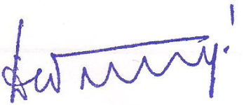
dGlobal Training and Consultancy Pvt. Ltd.
Data Protection Policy
The dGTC is committed to protect your personal information as per Indian national IT Act 2000 and The IT Rules 2021. The dGTC also confirms that such data shall be protected as per qualification awarding bodies (NEBOSH requirements and Data Protection Policy 1998, UK).
The information you have provided will be shared with other organizations for the purpose of administration, careers and other guidance and statistical and research purposes.
At no time will your personal information be passed to other organizations for marketing or sales purposes. From time to time students are approached to take part in surveys by mail and phone, which are aimed at enabling the dGTC and its partners to monitor performance, quality improvement and provision for future planning.
In order to ensure this dGTC has laid down a data control procedures and designated a Administrative Executive as data controller. The Director dGTC assumes overall responsibility of data protection under the local laws and other requirements applicable in conduct of the business.
The dGTC values your views on the education or training, which we received, and will be used, to bring improvements for learners. The dGTC or its partners may wish to contact you from time to time about the courses, or learning opportunities relevant to you.
Director
N Devchandra Singh
Pune
30/03/2024
dgtc/qhse/02

